Slide 1
Development of the Placenta

Slide 2
Learning Outcomes
List FIVE roles of the placenta
State why does maternal and foetal blood not mix
State what substances can pass across the placental membrane

Slide 3
The placenta begins to form after a fertilized egg implants in the uterus around seven to 10 days after conception.
It continues to grow throughout your pregnancy to support the baby.

Slide 4
Placenta Structure
A placenta is an organ of round or oval shape that is relatively flat.
The placenta is composed of two different surfaces
  - Maternal surface, facing the towards the outside, and the
  - Fetal surface, facing towards the inside, or the fetus.
On the fetal surface, the umbilical cord, links the placenta and the fetus.

Slide 5
Placental Circulation
Placental circulation encompasses two different circulation systems, the maternal and the fetal.
Although these two come in very close contact with each other, they will never mix together, they are separated by what is known as the placental barrier.
It is the nutrients, gases, wastes and hormones flow through by mainly diffusion.

Slide 6
Think…
… Although these two come in very close contact with each other, they will never mix together… why not?

Slide 7
Roles of the placenta
During pregnancy, the placenta has 6 main roles to maintain good health and a good environment for the growing child:
•Respiration
•Nutrition
•Excretion
•Protection
•Endocrine
•Immunity

Slide 8
1. Respiration
Early in pregnancy, the fetus does not have adequate developed lungs.
Therefore, one of the main functions of the placenta is to help the fetus breathe.
Oxygen rich blood coming from the mother enters the placenta by the maternal artery and diffuses into the fetal blood.
The oxygen will travel along the umbilical vein and finally reach the fetus.

Slide 9
2. Nutrition and Excretion
A good supply of nutrients for the fetus is needed for energy and a healthy growth.
Nutrients such as glucose, amino acids and fatty acids are essential to life and are mostly found in the foods we eat. Because the fetus is not physically eating, it is the mother that supplies these nutrients via the placenta.
Same for excretion

Slide 10
3. Protection
The placenta is a very important form of protection.
One of its functions is to prevent the mothers body from rejecting the fetus. Because the two can have different chromosomes and blood types, the mother would perceive the fetus as an object of foreign origin and would want to reject it because it is not part of her own tissues.
However, this scenario does not happen because the placenta serves as a barrier to prevent the two different circulation from mixing therefore the mothers immune system will not attack the fetus.

Slide 11

4. Immunity
The placenta also plays a role as a protective barrier against bacteria.
Most bacteria are too big to cross into the fetal circulation, however, micro-organisms such as viruses can do so and infect the fetus.
Drugs can also cross the barrier and cause harm to the baby. Drugs such as acetaminophen (tylenol) are harmless however others such as warfarin (an anticoagulant) are dangerous to the growing fetus
This Photo by Unknown Author is licensed under CC BY-SA

Slide 12
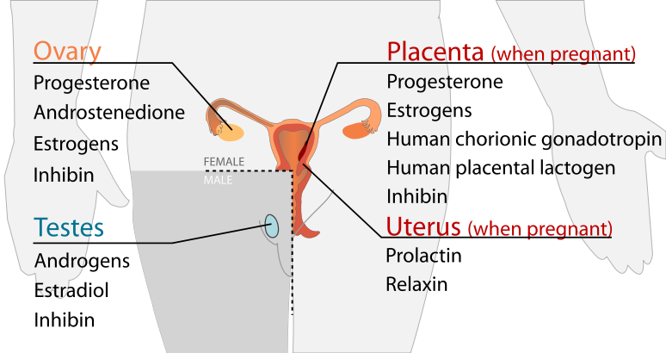
5. Endocrine (hormones)
An other main function of the placenta is acting as an endocrine gland which is a gland that secrets hormones directly into the blood acting as a regulator for the body.
The placenta secretes many different hormones into the blood stream to support pregnancy and fetal growth.
The 4 main hormones produced by the placenta are human chorionic gonadotropin (hCG), human placental lactogen (hPL), estrogens and progesterone.
They all playing a different role and have specific function during pregnancy.

Slide 13
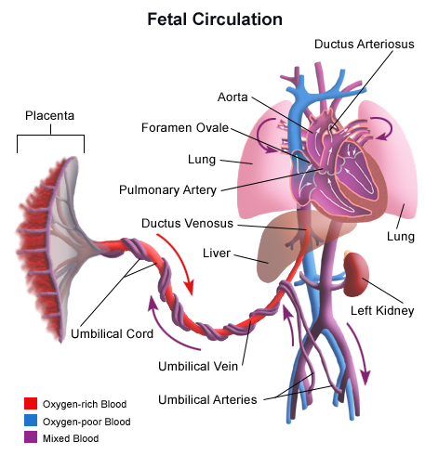
Umbilical Cord
The cord contains 2 arteries and 1 vein that are in continuation with the fetal circulation.
These vessels are longer then the cord and tend to twist and spiral to add strength and protect against entanglement, compression and tension.

Slide 14
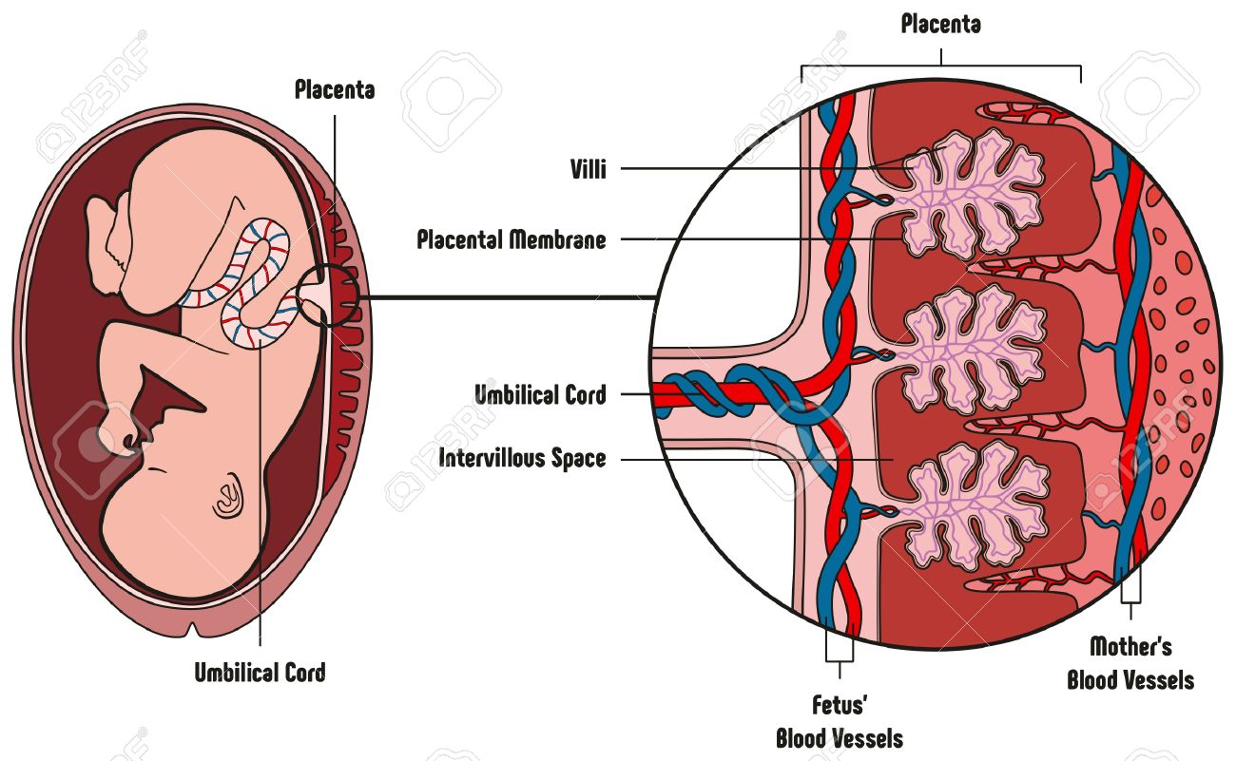

Slide 15
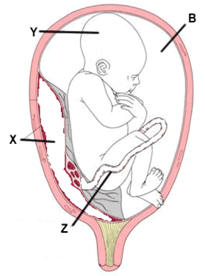
Label Diagram
Z – Umbilical cord
X – Placenta
Y – Fetus
B – Amniotic fluid

Slide 16
Substance | From mother to embryo | From embryo to mother
Oxygen
Carbon dioxide
Food
Waste
Alcohol
Drugs
Viruses (e.g. HIV)

Slide 17
Watch
https://www.youtube.com/watch?v=gHnFoWEVs7o

Slide 18
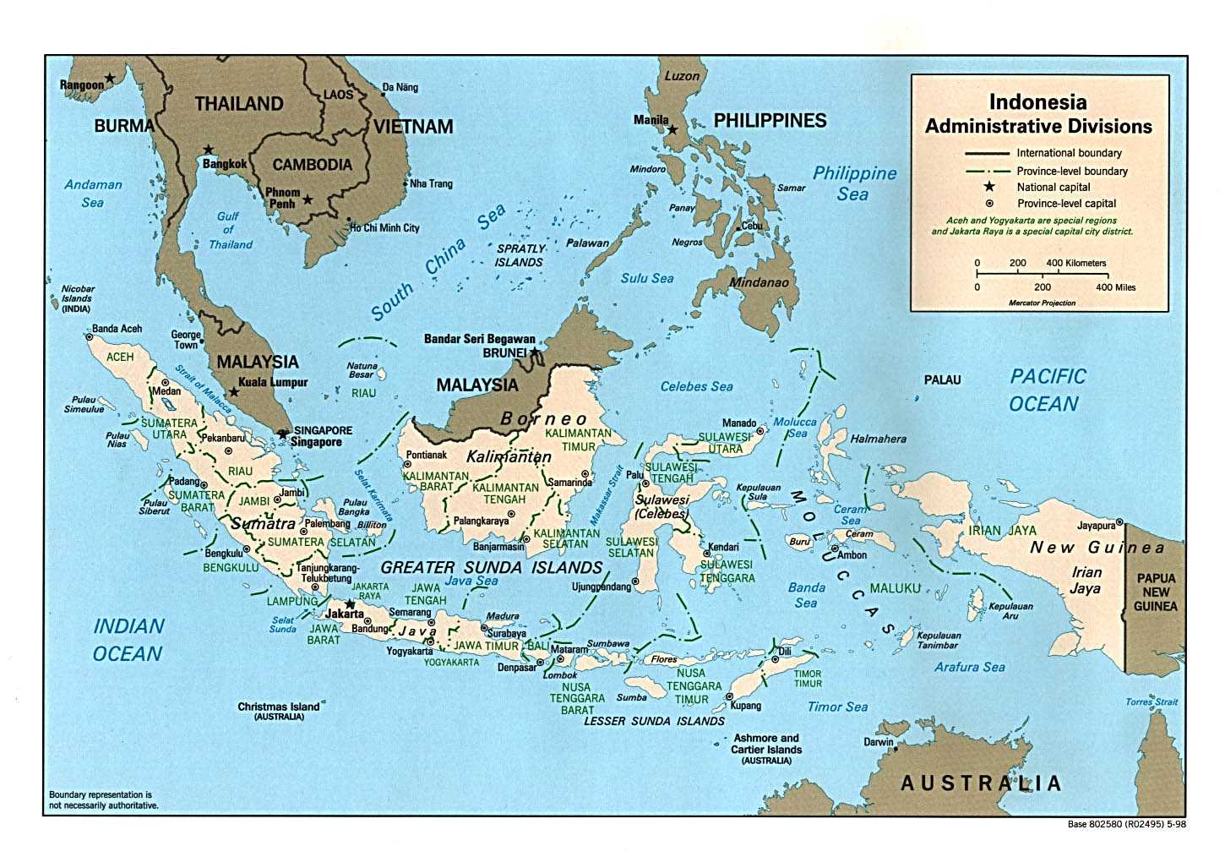
Traditions
Indonesia – On the day of birth, the father will clean, wrap and bury the placenta which will act as the babies guardian angel. The placenta is perceived as the baby’s twin which is why it must be buried according to their tradition.

Slide 19
Traditions
China – In this country, the placenta is seen as a force of life. They will dry it and then add it to recipes in order to consume it to increase vitality and energy.

Slide 20
Traditions
Africa – In certain regions of this continent, the placenta is wrapped up in blankets and planted under a tree. The tree then symbolizes ongoing life.

Slide 21
Traditions
Europe – In certain European tribes, the placenta is said to have its own spirit and is washed and then buried by the father in a shady place. If it is not done properly, it is believed that the mother or baby will become very sick.

Slide 22
Traditions
South America – In some regions, the placenta is burnt and planted in the ground in order to protect them from evil spirits.

